Slide 1
On whiteboard #1: Draw three sections
Draw solid solute in black marker | Draw water solvent in color marker | = Draw final mixture

Slide 2
On whiteboard #1: Draw three sections
Draw solid solute in black marker | Draw water solvent in color marker | = Draw final mixture

Slide 3
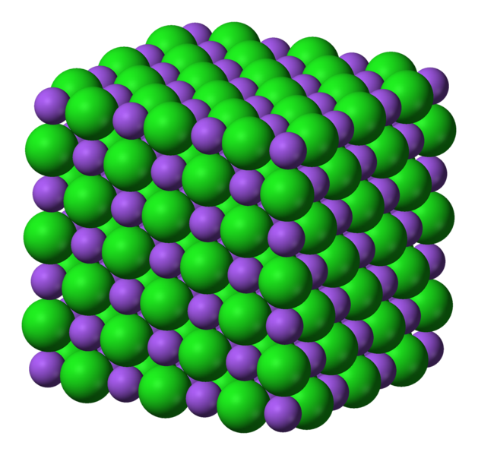
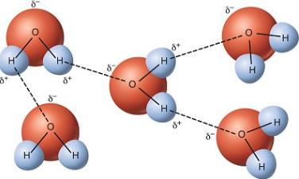
On whiteboard #1: Draw three sections
Draw solid solute in black marker | Draw water solvent in color marker | = Draw final mixture

Slide 4
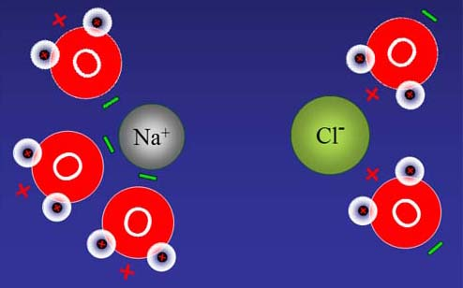
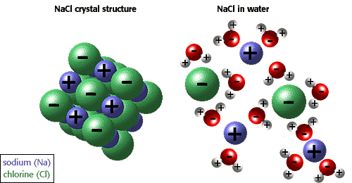

Slide 6
On whiteboard #2: Draw two sections
Draw concentrated salt & water | Draw diluted salt & water

Slide 7
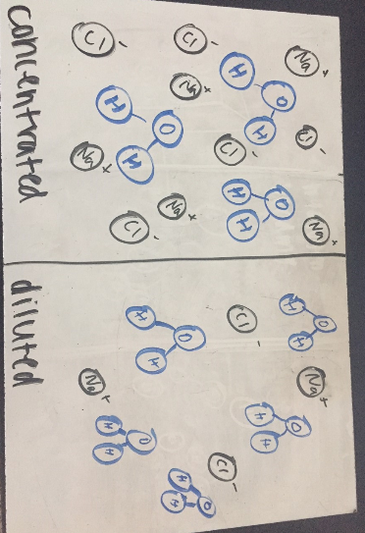
On whiteboard #2: Draw two sections

