Slide 1
Sig Fig Lab

Slide 2
Ruler #1

Slide 3
Ruler #2

Slide 4
Ruler #3

Slide 5
1. Which ruler was easier to use?
2. Which ruler provided a more exact measurement?
3. Which ruler required you to estimate?
4. How many numerical digits are in your centimeter measurement for the:
Ruler #1: ________________
Ruler #2: ________________
- Ruler #3: ________________

Slide 6
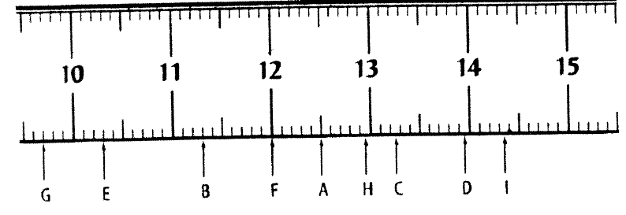
Read ruler

Slide 7
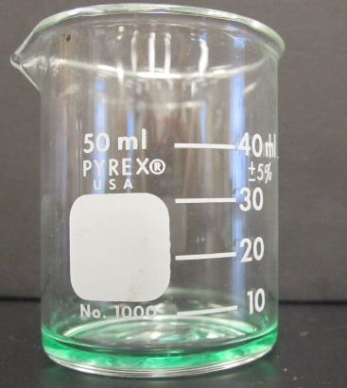
50 mL Beaker

Slide 8
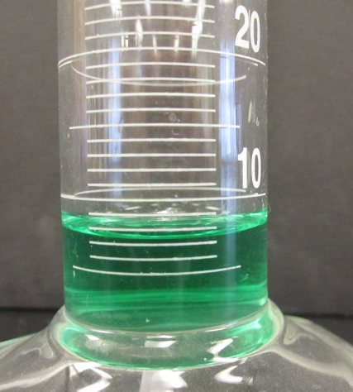
100 mL graduated cylinder

Slide 9
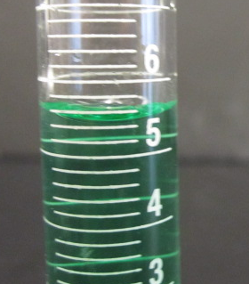
10 mL graduated cylinder

Slide 10
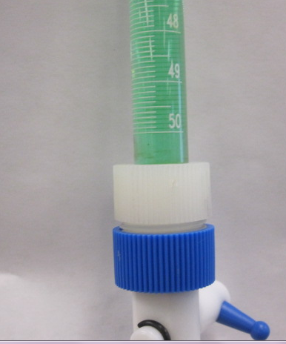
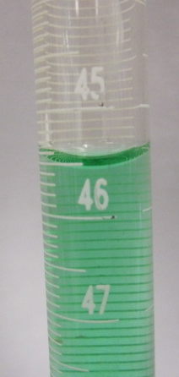
50 mL Buret

Slide 11
Conclusion
1. Which piece of glassware was easier to use?
2. Which piece of glassware provided a more exact measurement?
3. Which piece of glassware required you to estimate the most?
4. How many numerical digits are in your measurement for each piece of glassware:
50 mL beaker: ________________
100 mL graduated cylinder: ________________
10 mL graduated cylinder: ________________
Buret: _________________

Slide 12
Summary
When reading a measurement the last digit should ALWAYS be _____________________.

