Slide 1
1. | Water boils.
2. | A bicycle changes color as it rusts.
3. | A solid is crushed to a powder.
4. | Two substances are mixed and light is produced.
5. | Puddle evaporates.
6. | Chocolate syrup is dissolved in milk.
7. | A marshmallow is burned over a campfire.
8. | A marshmallow is cut in half.
P
C
P
C
P
P
C
P

Slide 2
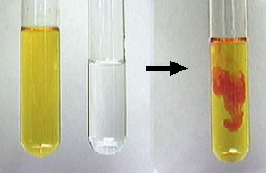
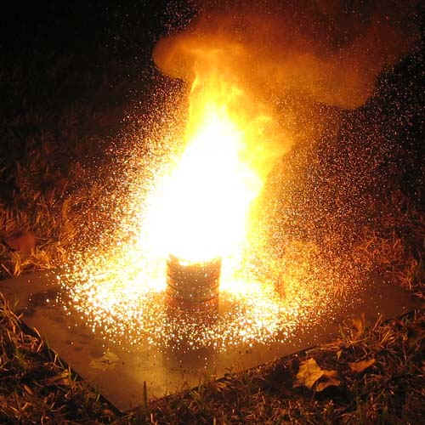
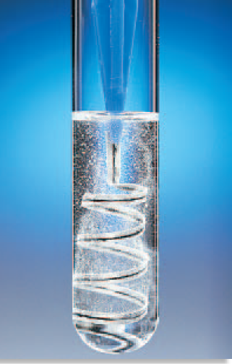
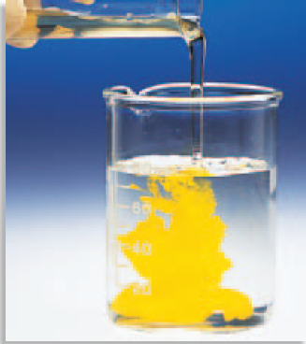
Indications of Chemical Change
Color change
Energy:
Light
Heat
Fire
Electricity
Gas production:
Bubbles
Fizzing
Smoke
Odor change
Precipitate

Slide 3
Basics
Change into
New
one or more substances
one or more substances
Reactant
Product

Slide 4
Law of Conservation of Matter/Mass
Matter is not created nor destroyed
Just rearranged
Total mass of reactants = total mass of products
Therefore, chem rxns must be balanced

Slide 5
Symbols used in equations
After a chemical formula:
(s) or ↓ : solid Cu_{(s)} CaCO₃ ↓
(g) or ↑ : gas : H_{2 (g)} O₂↑
(l) :liquid: H₂O_{(l)}
(aq) : aqueous solution: CaCl_{2 (aq)}
dissolved in H₂O

Slide 6
Other Symbols
Δ or heat :heat supplied to rxn
Chemical formula : catalyst

Slide 7
Reactions Rates

Slide 8
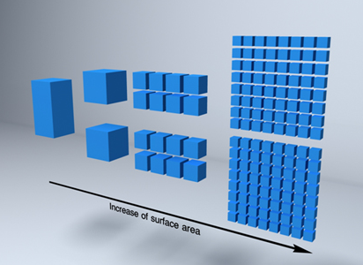
factors that effect rxn rate
1. Increase Temperature:
increasing in movement= more collisions
2. Increase Surface Area:
More smaller particles=
more areas to collide

Slide 9
3. Increase Concentration
Inc amount of a substance per area
Bigger M = more concentration
Which will cause a faster reaction: 3M or 0.4M
3M will make the rxn faster

Slide 10
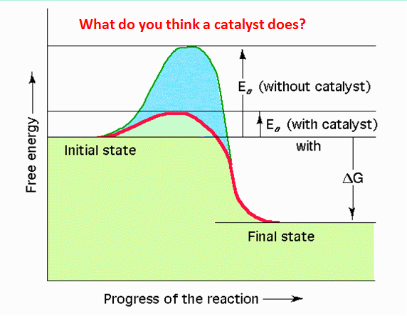

Slide 11
4. Catalyst
speeds up rxn w/o being used
Less activation energy is needed
Lowers the activated complex

Slide 12
6 types of reactions

Slide 13
C
+
O
O
→
O
C
O
What do you observe about this reaction?
What are the atoms doing?
This rxn is known as….

Slide 14
Combination/Synthesis
C
+
O
O
→
O
C
O
A + B ➔ AB
multiple reactants
forms
always 1 product
Mg _{(s)} + N_{2 (g)} →
Mg₃N₂ _{(s)}

Slide 15
Na
Cl
→
Cl
+
Na
What do you observe about this reaction?
What are the atoms doing?
This rxn is known as….

Slide 16
Decomposition
Na
Cl
→
Cl
+
Na
AB ➔ A + B
Always 1 reactant breaks down into multiple products
Compound falls apart
NiCO₃ _{(aq)} Δ
CO₂ _{(g)}
+ Ni _{(s)}

Slide 17
Cu
+
Zn
+
Zn
→
Cu
Cl
Cl
Cl
Cl
What do you observe about this reaction?
What are the atoms doing?
This rxn is known as….

Slide 18
Single Replacement/Displacement
Cu
+
Zn
+
Zn
→
Cu
Cl
Cl
Cl
Cl
AB + C ➔ CB + A
STRONGER single element
forms
new compound & new single element
kicks out
weaker

Slide 19
Single Replacement/Displacement
Cu
+
Zn
+
Zn
→
Cu
Cl
Cl
Cl
Cl
When determining strength..
**Look at Activity Series –table 3 pg 286

Slide 20
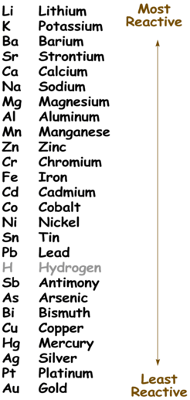
F₂ Fluorine
Cl₂ Chlorine
Br₂ Bromine
I₂ Iodine
Activity
Series
of
Metals
Activity
Series
of
NonMetals

Slide 21
Single Replacement/Displacement
Cu
+
Zn
+
Zn
→
Cu
Cl
Cl
Cl
Cl
When replacing an element….
**Metal kicks out Metal
**Nonmetal kicks out Nonmetal
2Na + SrCl₂ →
No Reaction
F₂ + LiCl →
LiF + Cl₂

Slide 22
Mg
Ca
Mg
Ca
+
→
+
O
S
S
O
What do you observe about this reaction?
What are the atoms doing?
This rxn is known as….

Slide 23
Double Replacement/Displacement
Mg
Ca
Mg
Ca
+
→
+
O
S
S
O
AB + CD ➔ AD + CB
Compounds “switch”
partners
forms
2 new compounds
ZnS + 2HCl →
ZnCl₂ + H₂S

Slide 24
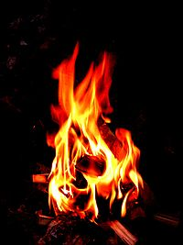
What do you need to make fire?
Can you light a fire on the moon?
What are the products of fire?

Slide 25
Combustion
C_{x}H_{y} + O₂ ➔ CO₂ + H₂O
Hydrocarbon + always ➔ always + always
oxygen carbon dioxide water
C₃H₈ + O₂ → CO₂ + H₂O

Slide 26
Acid –Base (Neutralization)
Acid (H⁺) + Base (OH⁻) → Salt + HOH
Ionic compound
HCl + NaOH → NaCl + H₂O

Slide 27
How to recognize which type
Look at the reactants
Element(E), Compound(C)
E + E
C
E + C
C + C
Acid + Base
Look at the Products
CO₂ + H₂O
Synthesis
Decomposition
Single replacement
Double replacement
Acid/Base reaction
Combustion

Slide 28
Na(s) + H₂O (l) ➔ NaOH ( aq) + H₂ (g)
2.CO(g) + O₂(g) ➔ CO₂
3.FeS(s) + HCl(aq) ➔ FeCl₂ (aq) + H₂S (g)
4. NaNO₃ (s) ➔ NaNO₂ (s) + O₂ (g)
5. CH₄(g) + O₂(g) ➔ CO₂(g) + H₂O (g)
6. Fe(s) + CuNO₃(aq) ➔ Cu(s) + Fe(NO₃)₂ (aq)
7. KI(aq) + Cl₂ (g) ➔ KCl (aq) + I₂(aq)
8. Al(s) + S(s) ➔ Al₂S₃ (s)
9. KClO₃ (s) ➔ KCl(s) + O₂ (g)
10. C₄H₁₀ (g) + O₂(g) ➔ CO₂(g) + H₂O (g)
SR
Combination
DR
Decomposition
Combustion
SR
SR
Combination
Decomposition
Combustion

Slide 29
All chemical rxns have…. a change in energy

Slide 30
E_{a}: activation energy:
Energy needed to start reactant collisions
thus starting the rxn
Activated Complex:
“top of the hill” reactants’ atoms rearrange
due to collisions.
ΔH: Enthalpy:
change in heat: products – reactants

Slide 31
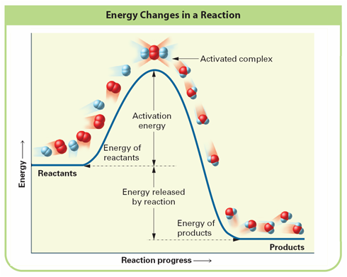
Collision Theory ( 1:17 min)

Slide 32
 | Endothermic | Exothermic
Sign
Descriptive Words
Drawing
“ Into”, absorb, heat added;
heat needed
Given off; heat produced; exit
surroundings
surroundings
system
system
heat
heat

Slide 33
Thermochemical Reactions
Endothermic
reactant+ heat ➔ product or reactant➔ product ΔH= + kJ
Exothermic
reactant➔ product + heat or reactant ➔ product ΔH= - kJ

Slide 34
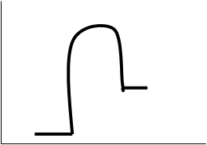
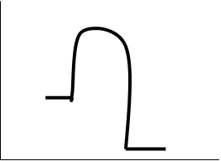
“ | Endothermic | Exothermic
Rxn Path diagram

Slide 35
Endothermic | Exothermic
Activated complex
Activated complex
E_{a}
E_{a}
Products
ΔH= -
heat
given
off
Reactants
ΔH= +
heat
added
Reactants
Products

Slide 36
Balancing Reactions
Balancing Act

Slide 37
STIPULATIONS
When balancing, only change the COEFFICENTS not the SUBSCRIPTS.

Slide 38
Steps
Write correct chemical formulas.
Count # of atoms for each element.
Balance each element or polyatomic ion.
REDUCE if possible.

Slide 39
Mg + O₂ ➔ MgO
1
1
Mg = Mg=
O = O=
2
1
Do the Mg match on both sides?
Yes
Need to balance
Do the O match on both sides?
No

Slide 40
Mg + O₂ ➔ MgO
2
2
1
2
2
Mg = Mg=
O = O=
both Mg now match
1
2
1
2
both O now match

Slide 41
Cu₂O + C ➔ Cu + CO₂
2
Cu = Cu=
O= O=
C= C=
1
1
2
1
1
Do the Cu match on both sides?
No
Need to balance
Do the O match on both sides?
No
Do the C match on both sides?
Yes

Slide 42
Cu₂O + C ➔ Cu + CO₂
2
4
2
4
Cu = Cu=
O= O=
C= C=
4
Matches √
1
1
2
Matches √
2
1
Matches √
1

Slide 43
Now, try a harder one in your notebook

Slide 44
C₂H₆ + O₂ ➔ CO₂ + H₂O
C= C=
H= H=
O= O=

Slide 45
C₂H₆ + O₂ ➔ CO₂ + H₂O
6
2
7
4
3
2
1
C= C=
H= H=
O= O=
4
4
6
12
2
6
12
2
14
3
5
14

Slide 46
N₂ + H₂ ➔ NH₃
Determine Type & Balance
#1
#2
KClO₃ ➔ KCl + O₂
#3
AgNO₃+ MgCl₂➔ AgCl+ Mg(NO₃)₂

Slide 47
N₂ + H₂ ➔ NH₃
N= N=
H= H=

Slide 48
___KClO₃ ➔ ____KCl + ____O₂
#2
K=
Cl=
O=
K=
Cl=
O=

Slide 49
__AgNO₃ + __MgCl₂➔ __AgCl + __Mg(NO₃)₂
# 3 ( #5 on WS)
Ag=
NO₃=
Mg=
Cl=
Ag=
NO₃=
Mg=
Cl=

