Slide 1
Chemical Changes
Affect the composition. New substance is made.

Slide 2
Additional Notes
Atoms are rearranged
A new substance is formed
Changes are not reversible
Energy is often produced

Slide 3
Indications

Slide 4
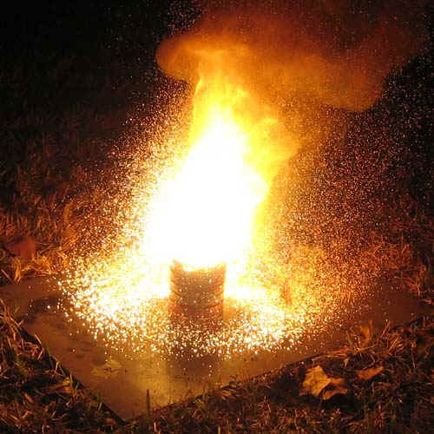
Energy
Fire, heat, electricity,
light,or change temp

Slide 5
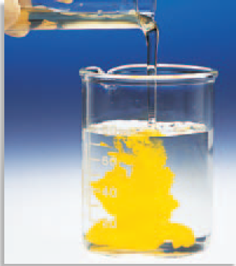
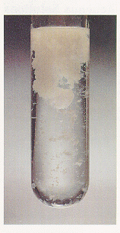
Precipitate ( liquid + liquid = solid)

Slide 6
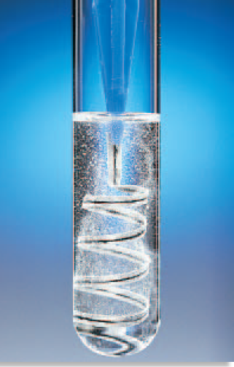
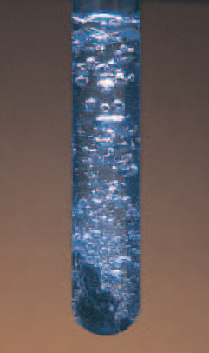
Gas
Bubbles or fizzing or smoke or odor change

Slide 7
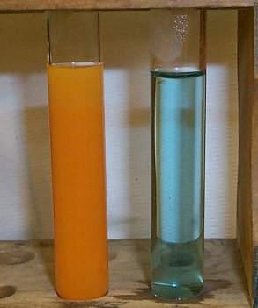
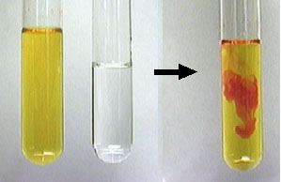
Color Change

