Slide 1
Take Five #1

Slide 2
Al(s) + 3AgNO₃(aq) → Al(NO₃)₂(aq) + 3Ag(s)
1. This equation represents which type of chemical reaction?
A Single-replacement
B Double-replacement
C Decomposition
D Synthesis
2. In the formula for barium chloride, (BaCl₂), barium (Ba) is written first because it is –
A a single atom
B a larger atom
C the positive ion
D the negative ion
Which element will most likely form covalent bonds with fluorine?
A Carbon
B Potassium
C Neon
D Tin

Slide 3
4. The physical process of evaporation involves –
A ion formation
B electron sharing
C transferring valence electrons
D overcoming intermolecular forces
5. A substance has molecular formula of C₈H₁₀N₄O₂. The empirical formula is –
A C₂H₆N₂O
B C₄H₅N₂O
C C₉H₇N₃O
D CHNO
6. What is the density of an aqueous solution that has a mass of 10.081 g and 12.5 mL? Your answer must use significant digits.

Slide 4
Take Five #2

Slide 5
1. The most efficient way to determine whether a reaction is an exothermic chemical reaction is to use —
A an oxygen probe
B a temperature probe
C a pressure probe
D a pH probe
2. What is the molarity of a solution with 0.2 moles of potassium permanganate (KMnO₄) dissolved in enough water to make a 500.0 mL solution?
A 0.0004 M
B 0.1 M
C 0.4 M
D 100 M
3. Which of these is NOT required to ensure that stock solutions are free of contamination?
A Store all solutions in brown bottles
B Do not place dropping pipettes in stock solution bottles
C Never return excess chemicals to stock bottles
D Replace tops on reagent bottles after use
Notes:
2009_11_A

Slide 6
4. What is the name for FeCl₃ using the IUPAC nomenclature rules ?
A Iron chloride
B Iron (II) chloride
C Iron trichloride
D Iron (III) chloride
5. Based on the information provided, which solution is a base and a weak electrolyte?
A NaHCO₃
B HClO
C NaNO₃
D CH₃NH₂
6. An expandable container of oxygen gas has a volume of 125 mL at a temperature of 25.0°C. What volume will the gas occupy at 55.0°C?
Notes:
2009_2_J

Slide 7
Take Five #3

Slide 8
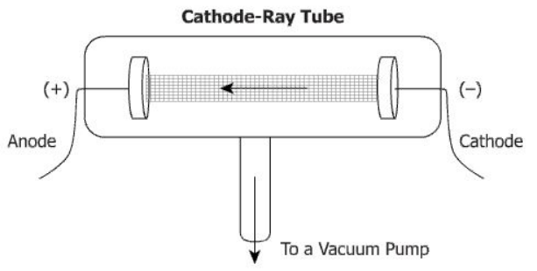
1. While English physicist J.J. Thomson was carrying out experiments on cathode rays, he was able to determine that the rays consisted of particles he called “corpuscles”. These particles were later named –
A protons
B electrons
C gamma rays
D neutrons
2. Which of these correctly describes how organic catalysts operate in biological reactions?
A They are used up in the reactions.
B They lower the overall energy of the reactions.
C They lower the activation energy of the reactions.
D They keep the temperature of the reactions constant.

Slide 9
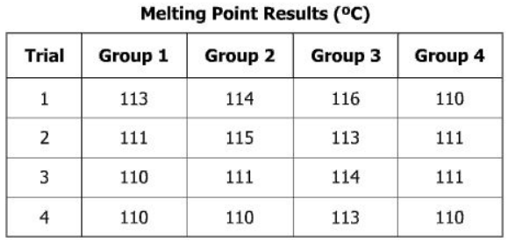
3. Each of four groups of students determined and recorded the melting point of a solid compound. If the actual melting point is 113°C, which group had the best precision?
A Group 1
B Group 2
C Group 3
D Group 4
4. Which structure represents a nonpolar molecule?

Slide 10
Take Five #4

Slide 11
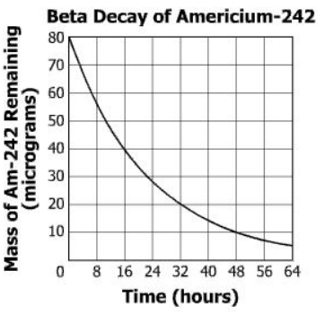
1. Using only one trial to collect data in an experiment –
A makes it easier to determine the a valid conclusion
B reduces the percent error in the results
C causes the conclusion to be less reliable
D requires data with more significant figures
2. A common product of acid-base neutralization reactions is —
A hydrogen
B water
C carbon dioxide
D oxygen
3. What is the half-life of Americium-242?
A 11 hours
B 16 hours
C 32 hours
D 64 hours
Notes:
2009_39_C

Slide 12
4. Two electrons are shared equally in bromine (Br₂). What type of bond is represented between the bromine atoms in this Lewis structure?
A Nonpolar covalent bond
B Polar covalent bond
C Metallic bond
D Ionic bond
In the Haber process, nitrogen (N₂) and hydrogen (H₂) are directly combined to form ammonia (NH₃). Which illustration contains the stoichiometric quantities of the reactants for this reaction?
Notes:
2009_17_B

Slide 13
Take Five #5

Slide 14
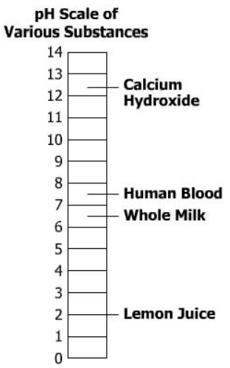
1. Which of these laboratory techniques is best to separate a solid from a liquid to recover the liquid?
A Titration
B Chromatography
C Filtering
D Vaporization
2. Which type of chemical reaction does this equation represent?
A Synthesis
B Neutralization
C Oxidation-reduction
D Double-replacement
3. Which of the four substances on this pH scale is slightly basic?
A Calcium hydroxide
B Human blood
C Whole milk
D Lemon juice
Notes:
2009_39_C

Slide 15
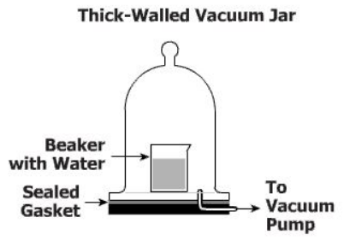
4. A beaker of water is placed in a large sealed jar that is attached to a vacuum pump. As air is pumped out of the jar, the water begins to boil because –
A the temperature of the water decreases as the surrounding pressure decreases
B the lower pressure inside the jar causes the water to contract
C the air pressure in the jar has been lowered until it is equal to the vapor pressure of the water
D the pressure on the water is insufficient to hold the hydrogen and oxygen atoms together, resulting in a decomposition reaction
5. An experiment produced 0.10 g CO₂ with a volume of 0.056 L at STP. If the accepted density of CO₂ at STP is 1.96 g/L, what is the approximate percent error?
A 110% C 71%
B 92% D 8.2%
Notes:
2009_17_B

Slide 16
Take Five #6

Slide 17
1. A student is studying the effects of several solutions on the prevention of the browning of apples. The student used solutions having different pH values and immersed three apple slices in equal volumes of each of the solutions. Which of these is the independent variable in this investigation?
A pH of solution
B Shade of brown
C Number of apple slices
D Volume of solutions
2. Which of these values is most responsible for changing the boiling and freezing points of a solvent?
A Molar mass of the solvent
B Electronegativity of the solvent
C Weight of the solute particles
D Number of the solute particles
3. Calculate the number of moles of Li₃PO₄ in 2.2 L of a 0.60 M Li₃PO₄ solution.
Notes:
2009_39_C

Slide 18
4. Equilibrium has been reached for the reaction shown. Which conclusion is correct?
A The N₂ and F₂ together will form at a faster rate than the NF₃.
B The partial pressure of N₂, F₂, and NF₃ will stay constant.
C The NF₃ will form at a faster rate than the N₂ and F₂ together.
D The partial pressure of NF₃ will keep changing.
5. If 89.6 joules of heat are needed to heat 20.0 grams of iron from 30.0°C to 40.0°C, what is the specific heat of the iron in $\frac{J}{g ∙ °C}$?
A 0.448
B 2.23
C 8.96
D 896
6. Increasing the volume of a sealed container will cause the gas particles within the container to –
A form a liquid
B collide more frequently
C increase in molecular attraction
D exhibit lower pressure
Notes:
2009_17_B

