Slide 1
Oxidation & Redox

Slide 2
What is the charge for each element?
Na₂S
CaO
Ga₂O₃
FeS₂

Slide 3
What is the charge for each element?
Na₂S
CaO
Ga₂O₃
FeS₂

Slide 4
Rules for Assigning Oxidation Numbers
 | Rule
1 | Neutral atoms & diatomic molecules = 0
2 | More electronegative element # = ion charge
3 | Fluorine always -1
4 | Oxygen is -2 unless in peroxide then -1 or with Fluorine than +2
5 | Hydrogen +1 unless combined with a metal then -1
6 | Sum of # = 0 when neutral or charge of polyatomic ion
0 (rule #1)
0 (rule #1)
a. Cl₂
b. Na

Slide 5
Rules for Assigning Oxidation Numbers
 | Rule
1 | Neutral atoms & diatomic molecules = 0
2 | More electronegative element # = ion charge
3 | Fluorine always -1
4 | Oxygen is -2 unless in peroxide then -1 or with Fluorine than +2
5 | Hydrogen +1 unless combined with a metal then -1
6 | Sum of # = 0 when neutral or charge of polyatomic ion
=+1 (#5)
=-2 (#2)
Recap:
Oxygen oxidation # is:
Hydrogen oxidation # is:
Sulfur oxidation # is:
-2
c. H₂ S O₄
+1
+2
?
-8
=0(#6)
+6
+6

Slide 6
Rules for Assigning Oxidation Numbers
 | Rule
1 | Neutral atoms & diatomic molecules = 0
2 | More electronegative element # = ion charge
3 | Fluorine always -1
4 | Oxygen is -2 unless in peroxide then -1 or with Fluorine than +2
5 | Hydrogen +1 unless combined with a metal then -1
6 | Sum of # = 0 when neutral or charge of polyatomic ion
Recap:
Oxygen oxidation # is:
Potassium oxidation # is:
Manganese oxidation # is:
=+1
=-2 (#2)
-2
d. K Mn O₄
+1
?
-8
=0
+1
+7
+7

Slide 7
Rules for Assigning Oxidation Numbers
 | Rule
1 | Neutral atoms & diatomic molecules = 0
2 | More electronegative element # = ion charge
3 | Fluorine always -1
4 | Oxygen is -2 unless in peroxide then -1 or with Fluorine than +2
5 | Hydrogen +1 unless combined with a metal then -1
6 | Sum of # = 0 when neutral or charge of polyatomic ion
=-1 (#3)
Recap:
Fluorine oxidation # is:
Oxygen oxidation # is:
-1
e. O F₂
+2
+2
-2
=0

Slide 8
Redox Reactions
L E O the lion goes G E R
O
S
E
L
E
C
T
R
O
N
S
X
I
D
A
T
I
O
N
A
i
N
L
E
C
T
R
O
N
S
E
D
U
C
T
I
O
N

Slide 9
1. Mg + Br₂ ➔ MgBr₂

Slide 10
2. 2H₂ + O₂ ➔ 2H₂O
3. Fe + CuCl₂ ➔ FeCl₂ + Cu

Slide 11
Equilibrium & Le Chatlier Principle

Slide 12
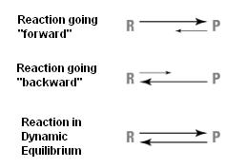

Slide 13
Le Chatlier Principle
When a system at equilibrium is subjected to a stress, the system will shift its equilibrium point in order to relieve the stress.

Slide 14
 | Equilibrium Reaction | Stress Applied | Shift
1 | gas↔heat + liquid | Add more gas
2 | Heat + solid ↔liquid | Lower the temperature
3 | Solid + heat ↔ liquid | Remove heat
4 | Heat + liquid ↔gas | Add liquid
5 | gas↔heat + liquid | Add liquid
6 | Liquid ↔heat + solid | Raise the temperature
7. | heat + solid ↔liquid | Remove liquid
8. | Gas ↔liquid + heat | Remove gas

Slide 15
Le Chatlier Principle Rules
1. Increase the Temperature or Heat causes the reaction to shift
2. Increase the concentration of reactant or product causes the reaction to shift
3. Increase the pressure causes the reaction with gases to shift

Slide 16
N₂ (g) + 3H₂ (g) ↔ 2NH₃ (g) + 92.1 kJ
 | Stress | Equilibrium Shift
1 | Add N₂
2 | Add NH₃
3 | Remove H₂
4 | Remove NH₃
5 | Increase temperature
6 | Decrease temperature
7 | Increase Pressure
8 | Decrease Pressure

Slide 17
Organic Chemistry

Slide 18
Organic Chemistry
study of carbon compounds that have at least one hydrocarbon, C-H, bond.
Carbon can form long chains with multiple bonds.

Slide 19
Saturated Bonds: contains maximum number of bonds (all single bonds)
Unsaturated Bonds: Does not contain the maximum number of bonds (there are double and triple bonds)

Slide 20
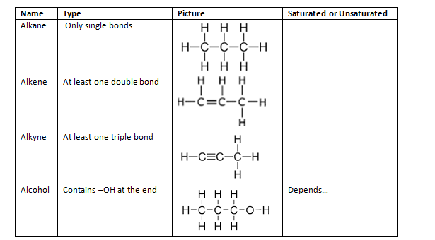

Slide 21
Alkane, alkene, alkyne, or alcohol?
Saturated or unsaturated?

Slide 22
Polymers: Repeating chains of molecules
A-B-A-B-A-B-A-B-A-B-A-B

Slide 23
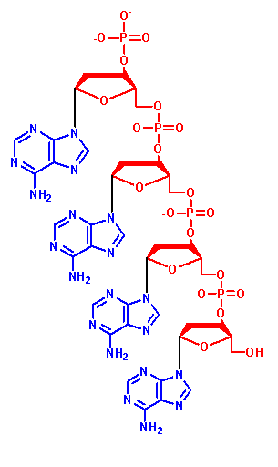
Natural Polymers:
DNA, RNA, proteins, cellulose, glycogen

Slide 24
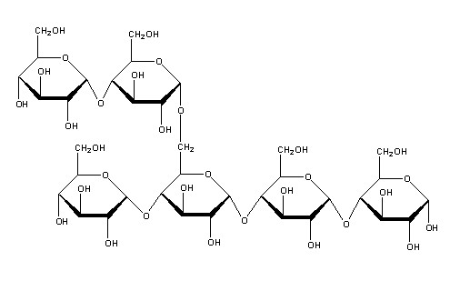
Synthetic Polymers:
Kevlar, polyester, plastic, nylon, rubber

