Slide 1
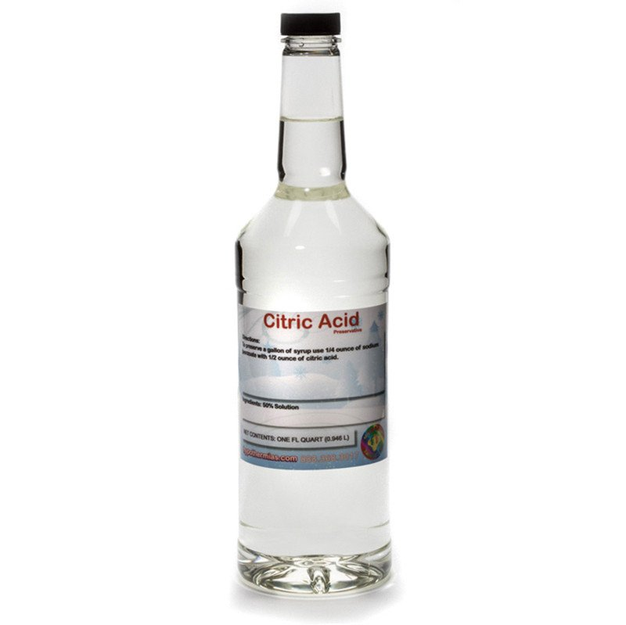
Indicators of Chemical Change Lab

Slide 2
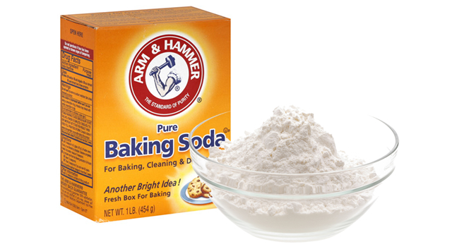
Part 1: Citric Acid Reaction

Slide 3
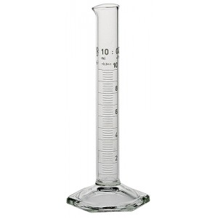
1. Measure 5 mL of citric acid

Slide 4
2. Measure 3 grams of baking soda

Slide 5
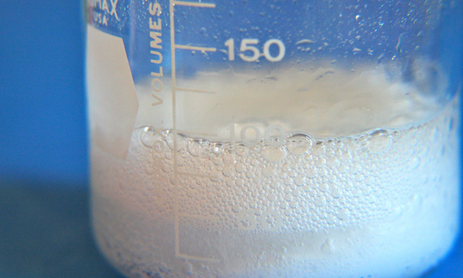
3. Add citric acid to baking soda

Slide 6
Part 2: The Test Tube Reaction Series

Slide 7
1. Add ten drops of CuSO₄

Slide 8
2. Add ten drops of Na₂CO₃

Slide 9
3. Add ten drops of HCl

Slide 10
4. Add ten drops of NaOH

