Slide 1
Molecular Polarity, Intermolecular Forces (IMF), & Likes dissolve Likes

Slide 2
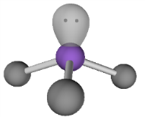
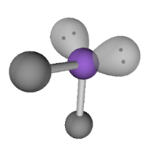
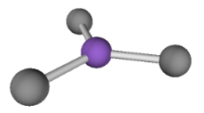
VSPER

Slide 3
VSPER

Slide 4
Bond Polarity: explains how the electrons are distributed in a bond

Slide 5
NONPOLAR
_____________ Bond: electrons shared equally ,evenly distributed; electronegativity range: _______________
0.0-0.3

Slide 6
POLAR
_____________ Bond: one atom have more control over the shared electrons, one atom is more electron dense. The electron density around a δ- is more compared to the density of a δ+. Electronegativity range: _______________
0.31-1.7
δ-
δ+

Slide 7
Molecular Polarity: explains how the electrons are distributed in the overall molecule

Slide 8
NONPOLAR
_______________ Molecule: the electrons spread out evenly through the molecular shape
_______________ Molecule: there is an area of high electron density & an area of low electron density.
POLAR

Slide 9
Intermolecular Forces (IMF)

Slide 10
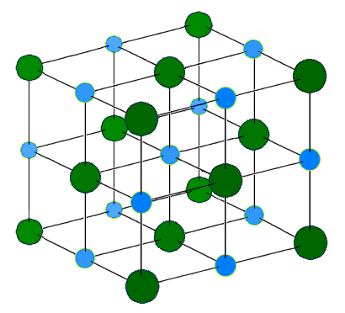
Ionic
Bond kept together by….
Crystalline structure

Slide 11
Covalent
Bond kept together by….interactions called
IMF = intermolecular force
attractions between molecules
(NOT the covalent bonds in the molecule!)

Slide 12
Stronger the attraction between molecules
=
__________ to separate molecules from one another
=
___________ energy to separate molecules
=
____________ melting and boiling point
Harder
More
Higher

Slide 13
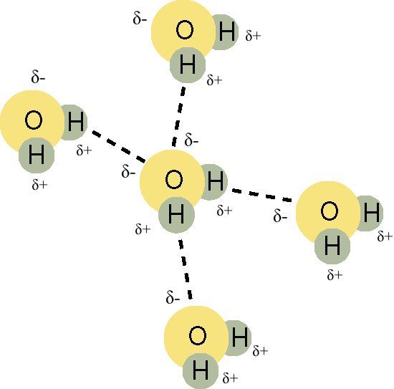
1. Hydrogen Bonding strongest
Highest MP & BP
Hydrogen attracted to:
N itrogen
O xygen
F luorine

Slide 14
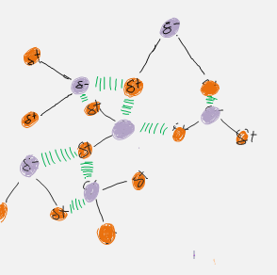
2. Dipole-Dipole [polar]
δ- end attracted /// to δ+ end of another

Slide 15
3. London Dispersion Forceweakest
-lowest MP & BP
*nonpolar molecules only have London forces &
poles (charged ends) are induced/generated.

Slide 16
3. London Dispersion Forceweakest
Electrons
____________ are constantly moving around in an atom
when the electrons are concentrated more on __________ side of the molecule it creates a temporary δ- pole.
one

Slide 17
Steps to Determining Molecular Polarity

Slide 18
Step 1
Determine all Bond Polarities
_______________ bond
( electrons evenly distributed)
=
Nonpolar molecule
(electrons evenly distributed)
NONPOLAR

Slide 19
Step 2
Draw the Lewis Structure
(be careful with your valence electrons)
Determine/Draw the Molecular Shape
add δ- & δ+ when applicable

Slide 20
Step 4
Split the molecule in half
Two different charges = has poles = has area of high & area of low electron density =_________ molecule
Same Charge = no poles = electrons evenly distributed= ______________ molecule
POLAR
NONPOLAR

Slide 21
Example CCl₄

Slide 22
Example CCl₄

Slide 23
 | Lewis structure | Molecular Shape | Bond Polarity | Molecular Polarity | IMF
NF₃ |  |  | F: N:_____
*BCl₃ Exception Boron only needs 6 e⁻ |  |  | Cl: B: ____
CH₃F |  |  | F: C:____ C: H: _____
Dipole-
Dipole
London-
_{Dispersion}
Hydrogen
_{Bonding}

Slide 24
Which of the example molecules form the table has the highest melting point?___________ Boiling point? ____________ Why?
CH₃F
CH₃F
CH₃F molecule has hydrogen bonding
= strongest force of attraction
=harder to separate molecules
= more energy needed to separate molecules
= higher MP & BP

Slide 25
flowchart

Slide 26
Recap how to make a solution (_________________ mixture)
HOMOGENOUS

Slide 27
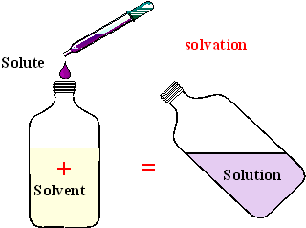
Solute
____________ gets added to the ____________.
_____________ does the dissolving
Solvent is generally in greater quantity.
Process is called solvation resulting in a solution
Solvent
Solvent

Slide 28
Likes Dissolve Likes

Slide 29
polar
Polar solvents dissolve ____________and _____________solutes because both have ________________ ends.
Nonpolar solvents dissolve ________________________ solutes
ionic
charged
nonpolar

Slide 30
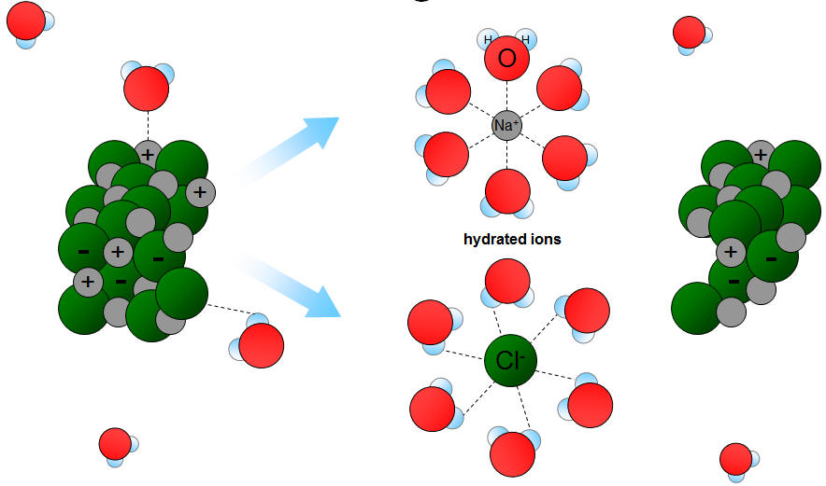
Likes Dissolve Likes

Slide 31
Likes Dissolve Likes DEMO

Slide 33
Likes Dissolve Likes
Determine the molecular polarity of water. Which of the class examples ( CCl₄, NF_{3,} BCl₃, CH₃F) will dissolve in water and why.

