Slide 1
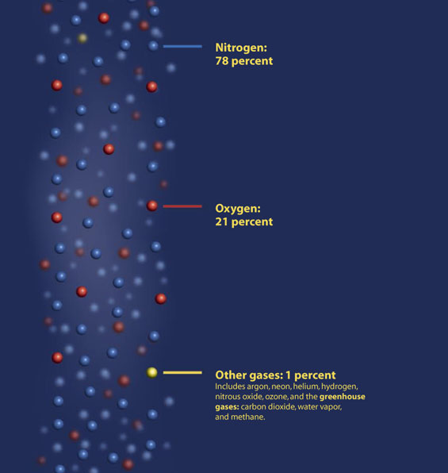

Slide 2
Dalton’s Law
P_{t} = P₁+P₂+P₃+ …..
( @ constant V & T)

Slide 3
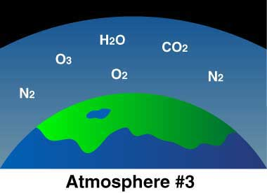

Slide 4
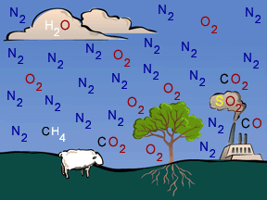

Slide 5
Dalton’s Law-Example
Air contains O₂, N₂, CO₂, and trace amounts of other gases. What is the partial pressure of oxygen (P_{Oxygen}) at sea level, if N₂ and CO₂ pressures are 79.10 kPa, 0.94 kPa, respectively?

Slide 6
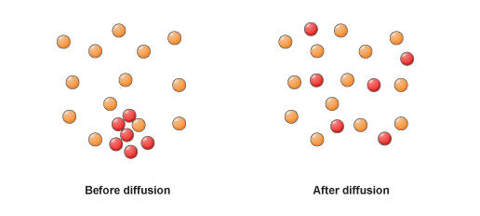
Diffusion
spreading of gas; gas particles move from areas of great concentration to areas with lower concentration until uniform.

Slide 7
Diffusion
What are some examples of diffusion?

Slide 8
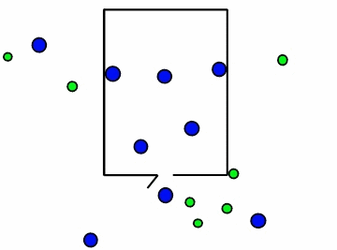
Effusion
gas escapes a container through tiny holes or pores of a container.

Slide 9
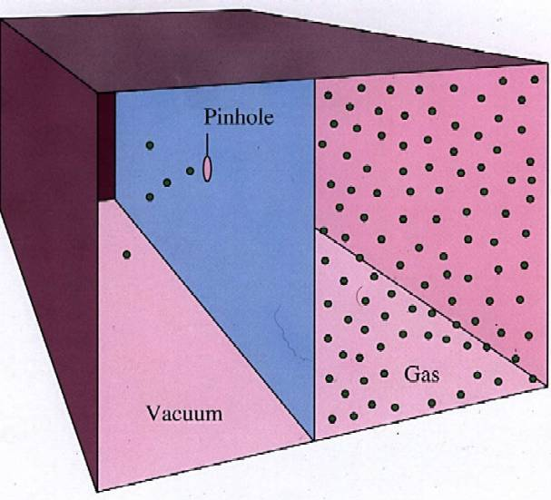
Effusion

Slide 10
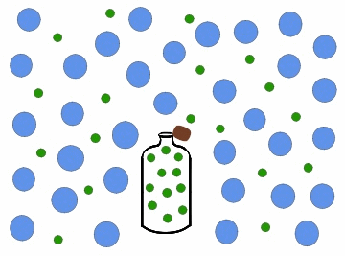
Diffusion & Effusion

Slide 11
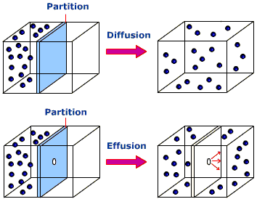
Diffusion vs Effusion

Slide 12
Effusion
if hole is small enough & gas particles big enough no effusion occurs.

Slide 13
Effusion
What are some examples of effusion?

Slide 14
Graham’s Law
Rate of Diffusion/Effusion : lighter gases move faster
Rate: speed, distance per time

Slide 15
Graham’s Law
http://www.youtube.com/watch?v=_oLPBnhOCjM

Slide 16
Applying Graham’s Law
Which gas effuses faster, NH₃ or CCl₄?
Which gas effuses faster, CO₂ or NF₃?

